Slide 1


Computational Intelligence (TC2023)

Slide 2
Unit V – Web System Protection (1)
Outline
What is required to protect a consumer Web?
Types of Abuse - Authentication and Account Takeover
Types of Abuse – Account Creation
Types of Abuse – Financial Fraud

Slide 3

What is required to protect a consumer Web?

Slide 4
What is consumer web?
consumer web: any service accessible over the public internet that provides a product to individual consumers; the service can be free or fee-based.
consumer web attack surfaces:
account access, payment interfaces, and content generation.
Social networks provide another dimension of vulnerability, as attackers can take advantage of the social graph to achieve their goals.

Slide 5
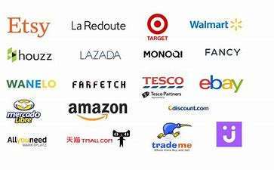

How a hacker directly monetized through attacking web consumer applications?

Slide 6


How a hacker directly monetized through attacking web consumer applications?

Slide 7

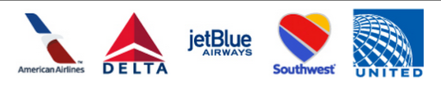
How a hacker directly monetized through attacking web consumer applications?

Slide 8
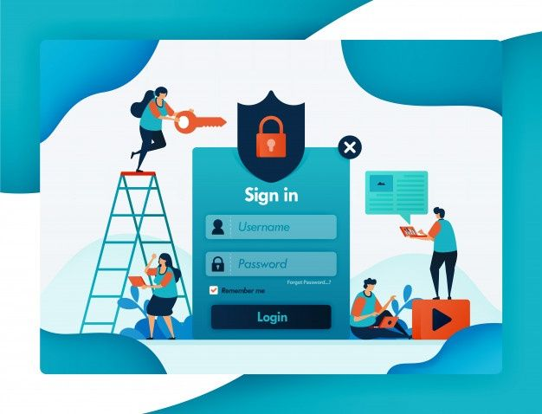
How a hacker directly monetized through attacking web consumer applications?
Protecting accounts on such a service is thus paramount for the site’s continued existence.

Slide 9
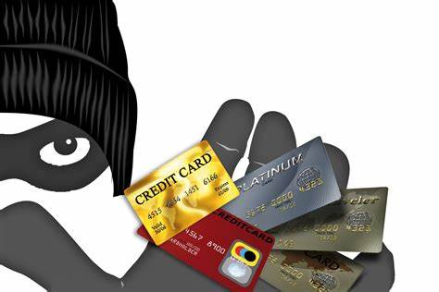
How a hacker directly monetized through attacking web consumer applications?
Fraud is another key concern for many consumer-facing websites.

Slide 10

How a hacker directly monetized through attacking web consumer applications?
Click fraud consists of bots or other automated tools clicking links for the sole purpose of increasing click counts.

Slide 11


How a hacker indirectly monetized through attacking web consumer applications?
Phishing

Slide 12
Types of Abuse - Authentication and Account Takeover

Slide 13
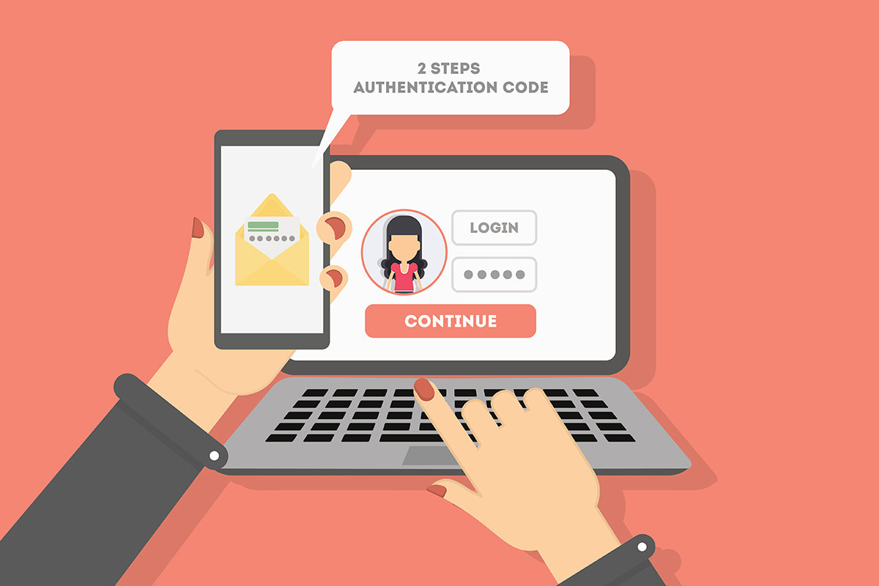
Authentication and Account Takeover
Authentication on the internet today overwhelmingly takes the form of passwords.
In the ideal situation, passwords serve to identify a user by verifying a snippet of information that is known only to that user.

Slide 14
Password Flaws
Users choose passwords that are easy to remember but also easy to guess.
Because it is nearly impossible to remember a unique, secure password for each site, people reuse passwords across multiple sites.
Users are vulnerable to “phishing” campaigns, in which a malicious email or website takes on the appearance of a legitimate login form, and tricks users into revealing their credentials.
Users might write down passwords where they can be easily read or share them with friends, family, or colleagues.

Slide 15
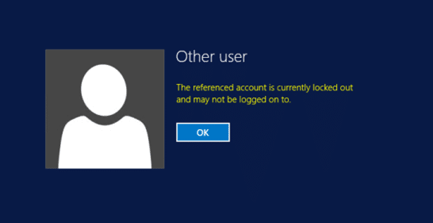
Features Used to Classify Login Attempts
Signals indicating a brute-force attack on a single account;
Signals indicating a deviation from this user’s established patterns of login;
Signals indicating large-scale automation of login.

Slide 16

Brute-force attack on a single account:
Velocity of login attempts on the account—simple rate limiting can often be effective
Popularity rank of attempted passwords—attackers will try common passwords
Distribution of password attempts on the account—real users will attempt the same password or similar passwords

Slide 17
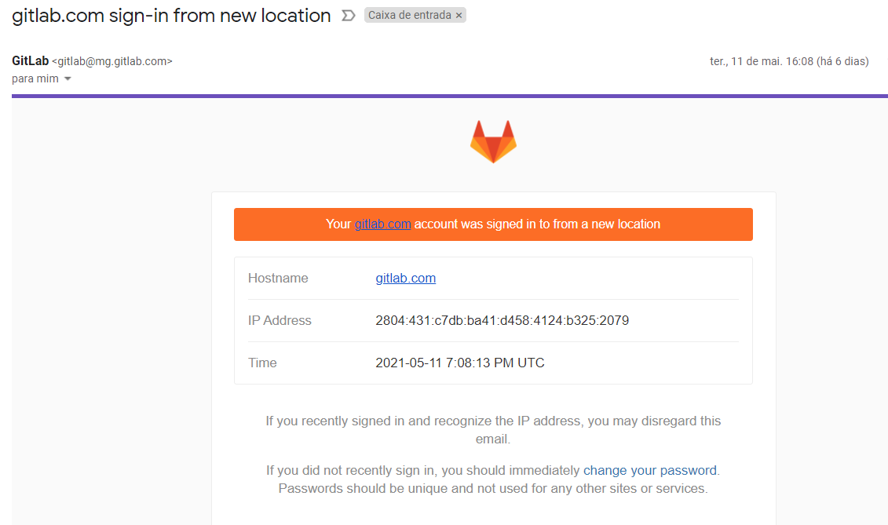
Deviation from this user’s established patterns of login
Geographic displacement from previous logins (larger distances being more suspicious)
Using a browser, app, or OS not previously used by the account
Appearing at an unusual time of day or unusual day of the week
Unusual frequency of logins or inter-login time
Unusual sequence of requests prior to login

Slide 18
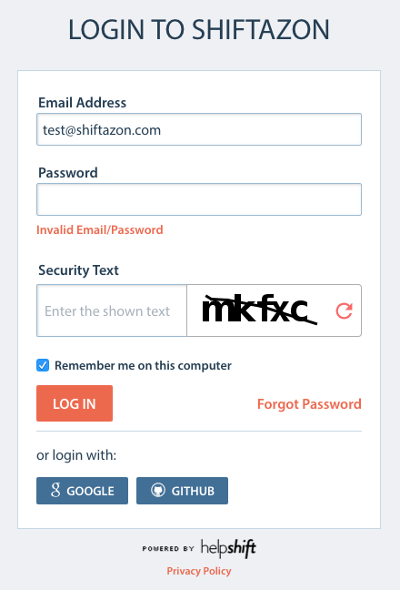
Large-scale automation of login
High volume of requests per IP address, user agent, or any other key extracted from request data
Unusually high number of invalid credentials across the site
Requests from a hosting provider or other suspicious IP addresses
Browser-based telemetry indicating nonhuman activity—e.g., keystroke timing, captcha or device-class fingerprinting

Slide 19

Feature Engineering
Engineering all of these features is a nontrivial task.
Labeling account compromise is an imprecise science.
Let’s assume you don’t have any labeled data. How do you use the signals described here to detect suspicious logins?

Slide 20
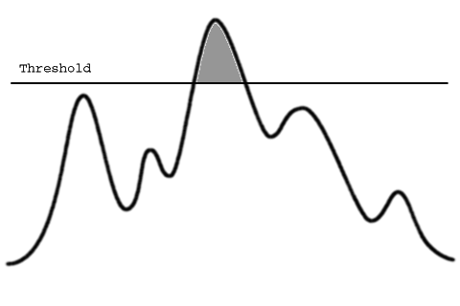
Try is to set thresholds on each of the features
For example, you could require extra verification if a user logs in more than 10 times in one hour, or more than 500 miles from any location at which they were previously observed or using an operating system they haven’t previously used.

Slide 21

Statistical Approach
How can we estimate the probability that the person logging in is the account owner?

Slide 22


Dependent and Independent Events
Independent events: the occurrence of one event does not affect the occurrence of the other.
Dependent events: the occurrence of one event influence the probability of the other event.

Slide 23
Joint Probability
P(A ^ B)
This is the probability of two or more events to occur together.
This is not the same as the conditional probabilities among two or more events [e.g., P(A|B) or P(B|A)], or the probability of either one to happen [e.g., P(A, B)].
It is usually denoted by P(AB).
P(B)
P(A)
P(B)
P(B^C)
P(C)
P(A^B)
P(A^C)
P(A)
P(A ^ B ^ C)

Slide 24

Conditional Probability
It is a measure of the probability of an event occurring given that another event has (by assumption, presumption, assertion or evidence) occurred.
given B is true, what is the probability that A is also true.
What’s the probability of someone sleeping less than 8 hours if they’re a college student?

Slide 25


Conditional Probability
It is a measure of the probability of an event occurring given that another event has (by assumption, presumption, assertion or evidence) occurred.
given B is true, what is the probability that A is also true.
What’s the probability of a student's grade is 'A’ if he went to the party a day before the Final Exam?

Slide 26
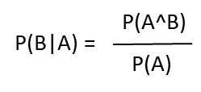
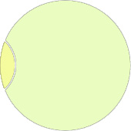
Conditional Probability
P(B|A) = probability of B occurring, given A occurs P(A ∩ B) = probability of both A and B occurring P(B) = probability of B occurring
P(A ^ B)
P(B)
P(A)
P(A^B)
P(B|A) =
P(A)
Figure 2
Figure 1

Slide 27
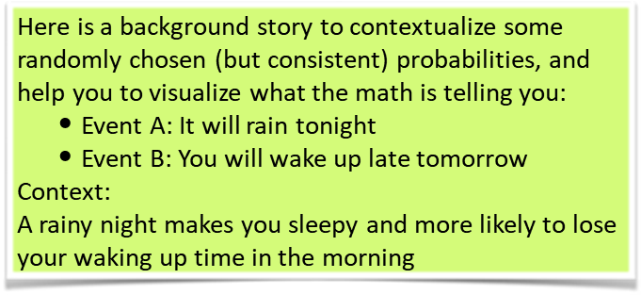

Conditional Probability (Example)

Slide 28
Conditional Probability
It is the probability of one or more events to occur given (i.e., conditional to) other events have occurred.
P(A|B, C) means the probability of event A given the fact that events B and C have occurred.

Slide 29
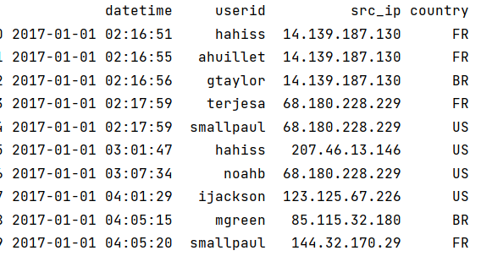
Applying Conditional Probabilities
Suppose that we have a user (u=u) that log in using an IP address (x=X).
How likely is the user ‘'hahis’ log in using an IP='14.139.187.130'?
$$p\left(User=\text{′}\text{hahis}′ | IP=\text{′14.139.187.130′}\right)= ???$$

Slide 30
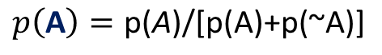
Applying Conditional Probabilities
Suppose that we have a user (u=u) that log in using an IP address (x=X).
How likely is the user ‘'hahis’ log in using an IP='14.139.187.130'?
$$p\left(User=\text{′}\text{hahis}′ | IP=\text{′14.139.187.130′}\right)= ???$$
𝑈𝑠𝑒𝑟=′hahis′ | 0 | 1
IP='14.139.187.130'
0 | 6 | 1
1 | 2 | 1
$$p\left(\text{A}\right)=\text{p}\text{(}\text{A}\text{)/[}\text{p}\text{(}\text{A}\text{)+}\text{p}\text{(\sim }\text{A}\text{)]}$$
$$p\left(\text{User}\text{=′}\text{hahis}\text{′}\right)=\text{(}\text{1+1)/(1+1+6+2)=2/10=0.2}$$
$$p\left(\text{IP}\text{=′14.139.187.130′ }\right)=\text{(}\text{2+1)/(1+1+6+2)=3/10=0.3}$$
$$p\left(\text{User}\text{=′}\text{hahis}\text{′}∩ \text{IP}\text{=′14.139.187.130′ }\right)=\text{(}\text{1)/(1+1+6+2)=3/10=0.1}$$

Slide 31
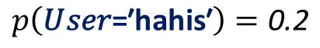
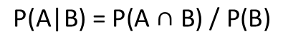
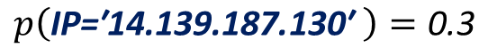
Applying Conditional Probabilities
Suppose that we have a user (u=u) that log in using an IP address (x=X).
How likely is the user ‘'hahis’ log in using an IP='14.139.187.130'?
$$p\left(\text{User}\text{=′}\text{hahis}\text{′}\right)=\text{0.2}$$
$$p\left(\text{IP}\text{=′14.139.187.130′ }\right)=\text{0.3}$$
$$\text{P}\text{(}\text{A}\text{|}\text{B}\text{) = }\text{P}\text{(}\text{A}\text{ ∩ }\text{B}\text{) / }\text{P}\text{(}\text{B}\text{)}$$
$$p\left(\text{User}\text{=′}\text{hahis}\text{′}∩ \text{IP}\text{=′14.139.187.130′ }\right)=\text{0.1}$$
$$p\left(User=\text{′}\text{hahis}′ | IP=\text{′14.139.187.130′}\right)= ???$$
$p\left(User=\text{′}\text{hahis}′ | IP=\text{′14.139.187.130′}\right)$ = 0.1/0.3 = 0.33

Slide 32
Applying Conditional Probabilities
How likely is the user ‘'hahis’ using the IP ‘14.139.187.130’ can be log in from BR?
$p\left(hahis, 14.139.187.130 | BR\right)= \frac{p⁡(BR∩harris∩14.139.187.130)}{p⁡(BR)}=\frac{0}{p⁡(BR)}$
If the probability of user u logging in from IP x and country BR is zero, this login must be an attack.
Thus, if we took this calculation at face value, we would need to regard every login from a new IP address or country as suspicious.
$$p\left(hahis, 14.139.187.130 | BR\right)=0$$

Slide 33
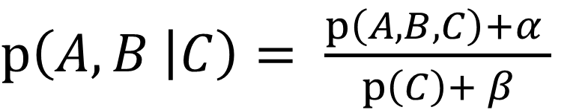
Applying Conditional Probabilities
How likely is the user ‘'hahis’ using the IP ‘14.139.187.130’ can be log in from BR?
To avoid the issue of zero probabilities, we can smooth by adding “phantom” logins to the user’s history.
Specifically, we add β login events from the COUNTRY, α of which are from the IP / user/ COUNTRY in question.
$p\left(A,B | C\right)= \frac{p\left(A,B,C\right)+α }{p\left(C\right)+ β}$

Slide 34
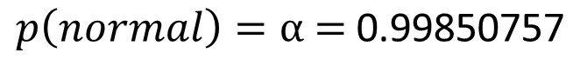
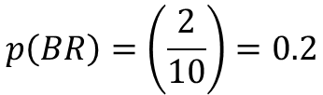
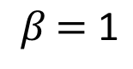
Applying Conditional Probabilities
How likely is the user ‘'hahis’ using the IP ‘14.139.187.130’ can be log in from BR?
$$p\left(normal\right)=α\text{ = }\text{0.99850757}$$
$$β\text{ = }\text{1}$$
$$p\left(BR\right)=\left(\frac{2}{10}\right)=0.2$$
$p\left(\left(hahis∩IP\right) | BR\right)= \frac{p\left(hahis∩IP∩BR\right)+0.99850757 }{p\left(BR\right)+1}$
$$p\left(\left(hahis∩IP\right) | BR\right)= \frac{0+0.99850757 }{0.2+1}=\frac{0.99850757}{1.2}=0.832$$

Slide 35
How about the “large-scale automation” features?
To calculate velocity features, we need to keep rolling counts of requests over time that we can look up on each incoming request.
For example, we should keep track of the following (among others):
Number of successful/failed login attempts sitewide in the past hour/day
Number of successful/failed login attempts per IP address in the past hour/day
Number of successful/failed login attempts per user agent in the past hour/day

Slide 36
To determine whether there is an unusually high number of invalid credentials across the site:
calculate the login success rate for each hour over a sufficiently large historical period and use this data to compute the mean and standard deviation of the success rate.
compute the success rate over the past hour and determine whether this value is acceptably close to the historical mean.
using heuristics: failure rates two or three standard deviations above the mean should trigger alerts or additional friction.
Using probability: you can use on failure rate per IP or failure rate per user agent.

Slide 37
“requests from a suspicious entity” features:
To accurately capture these features, you need reputation systems that assign to each entity (e.g., IP address) either a label or a score that indicates the prior level of suspicion.
For example: hosting providers would typically have low scores.

Slide 38
The Classifier
Without labels: anomaly detection.
With labels: supervised classifier.

Slide 39
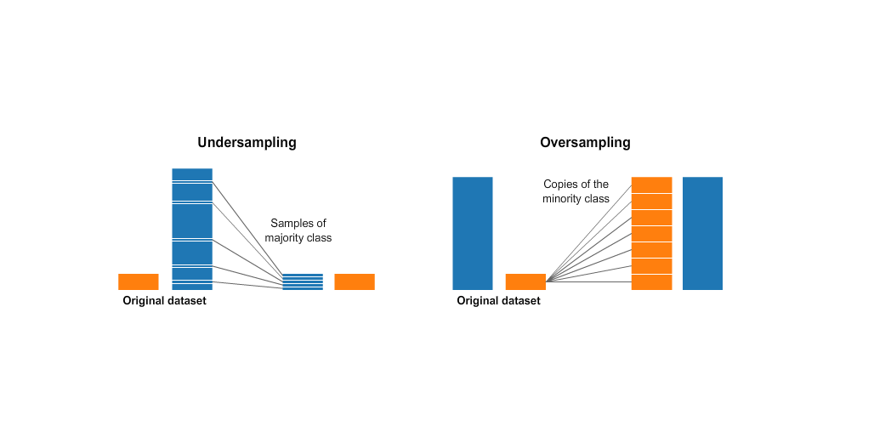
Supervised Classifier
Typically, your labels will be highly unbalanced (there will be very little labeled attack data), so you will want to use a technique such as undersampling the benign class or adjusting the cost function for the attack class.

Slide 40
Types of Abuse – Account Creation

Slide 41

Account Creation
Attacks such as sending spam or fake content can be carried out from accounts created and owned by the attacker.
If attackers can create a large number of accounts, your site could potentially be overwhelmed by illegitimate users.
Thus, protecting the account creation process is essential to creating a secure system.

Slide 42

General Approaches To Detecting And Weeding Out Fake Accounts
scoring the account creation request to prevent fake accounts from being created at all,
scoring existing accounts in order to delete, lock, or otherwise restrict the fake ones.

Slide 43
General Approaches To Detecting And Weeding Out Fake Accounts
scoring the account creation request: blocking during the creation process prevents attackers from doing any damage at all, and also keeps the size of your account database under control.
scoring existing accounts: scoring after the fact allows greater precision and recall, due to the fact that more information is available about the accounts.

Slide 44


Scoring the Account Creation Request
Velocity features
Reputation scores

Slide 45
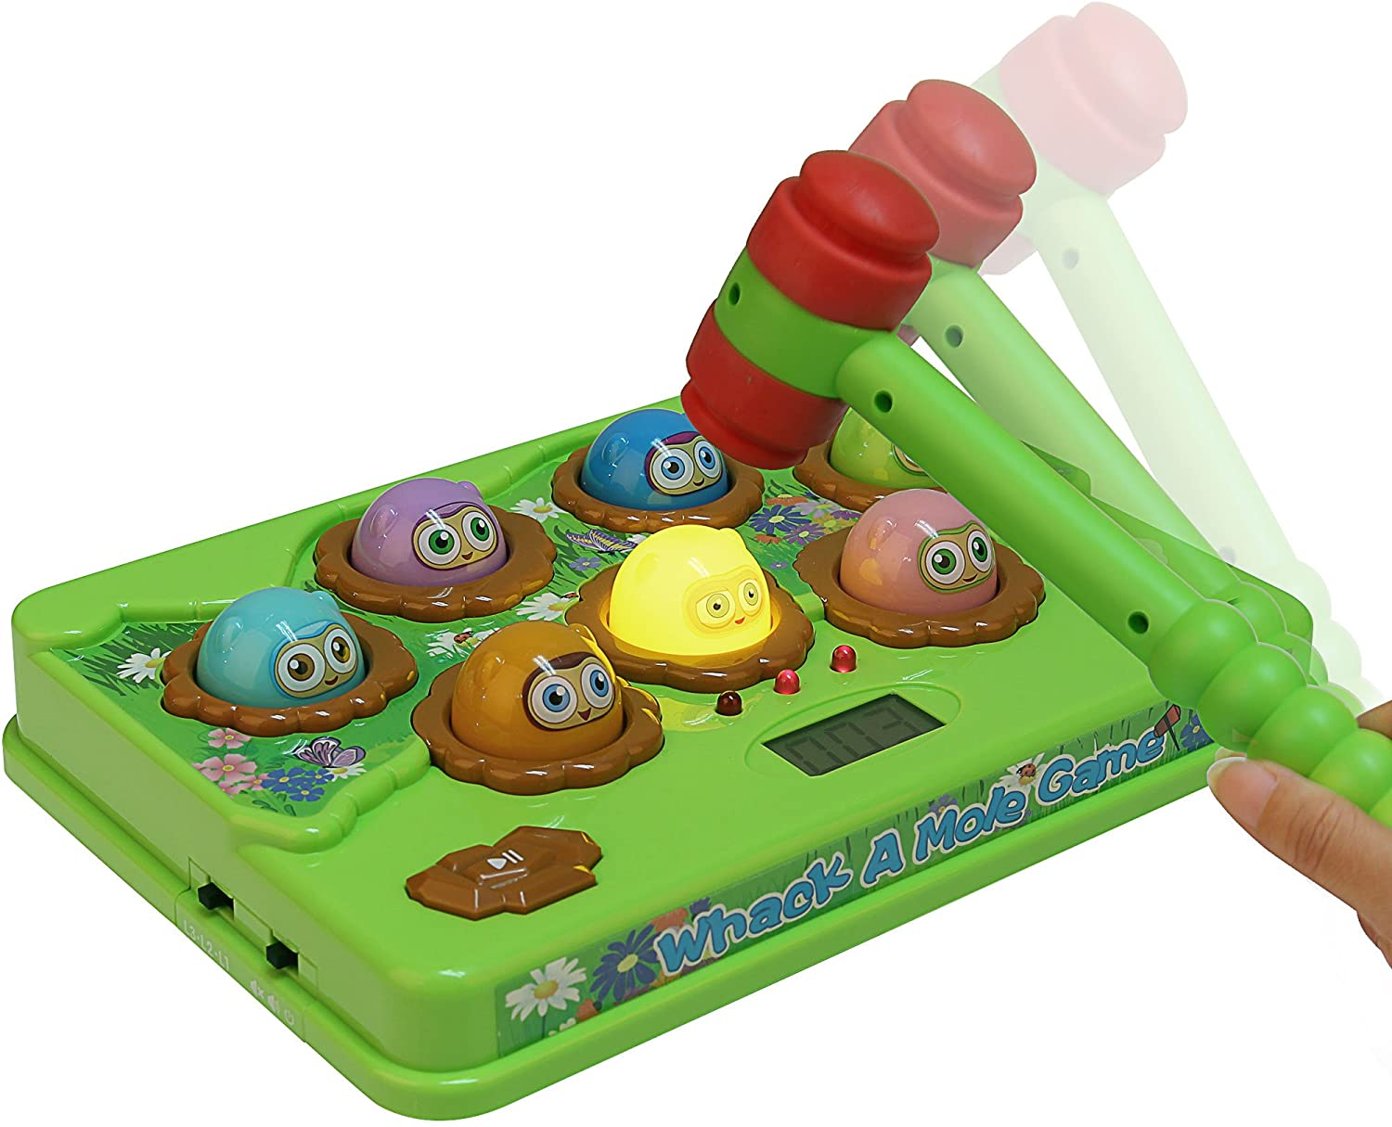
Velocity features
When an attacker is flooding your system with account creation requests, you don’t want to build a complicated machine learning model—you just want to block the offending IP address.
But then the attacker will find a new IP address, and now it becomes a game of whack-a-mole.
To avoid this game and create a robust, automated defense, we use velocity features.

Slide 46
Velocity Feature
The basic building block of a velocity feature is a rolling counter.
A rolling counter divides time into k buckets (e.g., each hour of the day) and for each key in a key space (e.g., the set of all IP addresses) maintains the count of events for that key in each bucket.
At set intervals (e.g., on every hour), the oldest bucket is cleared, and a fresh bucket is created.
At any point we can query the counter to get the number of events for a given key in the past t buckets (if t ≤ k).

Slide 47
Velocity Feature
After you have rolling counters, you can begin counting account creation attempts by any number of different keys, at one or more granularities of time.

Slide 48
Velocity Feature
IP address or IP subnet
Geolocation features (city, country, etc.)
Browser type or version
Operating system and version
Success/failure of account creation
Features of the account username (e.g., substrings of email address or phone number)
Landing page in the account creation flow (e.g., mobile versus desktop)
API endpoint used
Any other property of the registration request

Slide 49
Velocity Feature
Ratio of success to failure on login or registration (failure spikes are suspicious)
Ratio of API requests to page requests (the API being hit without a corresponding page request suggests automation, at least when the user agent claims to be a browser)
Ratio of mobile requests to desktop requests
Ratio of errors (i.e., 4xx response codes) to successful requests (200 response code)

Slide 50
Reputation Score
Velocity features are good at catching high-volume attacks
What if the attacker slows down and/or diversifies their keys to the point where the requests are coming in below the threshold for any given key?
How can we make a decision on a single request?

Slide 51
Reputation Score
Reputation quantifies the knowledge we have about a given key (e.g., IP address) either from our own data or from third parties and gives us a starting point (or more formally, a prior) for assessing whether a request from this key is legitimate.

Slide 52
Reputation Score
The simplest reputation signal for a registration defense model is the fraction of accounts on that IP that have been previously labeled as bad.
A more sophisticated system might capture other measures of “badness”: how many account takeover attempts have been seen from the IP, or how much spam has been sent from it?

Slide 53
Reputation Score
But if you do not have labels:
How long ago was the IP first seen? (Older is better.)
How many legitimate accounts are on the IP?
How much revenue comes in from the IP?
How consistent is traffic on the IP? (Spikes are suspicious.)
What’s the ratio of reads to writes on the IP? (More writes = more spam.)
How popular is the IP (as a fraction of all requests)?

Slide 54
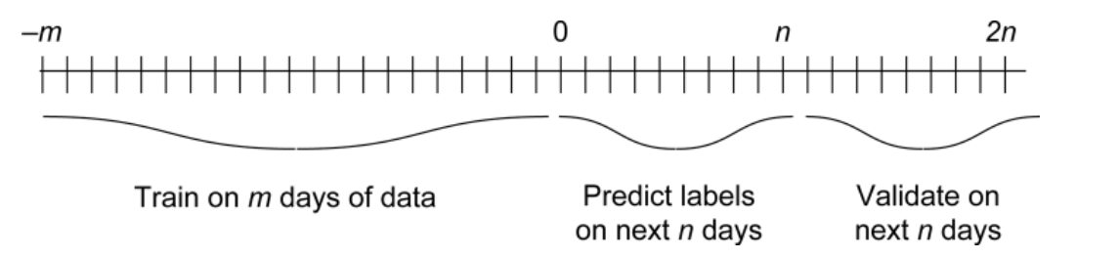
How to use the data into Supervised ML

Slide 55
Types of Abuse – Financial Fraud

Slide 56
Financial Fraud
Most of the financial fraud is conducted using stolen credit cards.
Credit card fraud is older than the internet, and an enormous amount of work has been done to understand and prevent it.
A single credit card transaction passes through many different entities as it is processed: merchant (you); payment processor; merchant’s bank; card network (Visa/Mastercard/American Express/Discover), which routes inter-bank transactions; and the card issuer’s bank.

Slide 57
Indicative of Financial Frauds
Spending profiles of customers
Geographical/time-dependency correlation
Data mismatch
Account profile
Customer interaction statistics

Slide 58
Spending profiles of customers:
How many standard deviations from the customer’s average purchase a given transaction is
Velocity of credit card purchases
Prevalence of the current product or product category in the customer’s history
Whether this is a first purchase (e.g., a free user suddenly begins making lots of purchases)
Whether this payment method/card type is typical for the customer
How recently this payment method was added to the account

Slide 59
Geographical/time-dependency correlation
All the correlation signals for authentication (e.g., geographic displacement, IP/browser history)
Geographic velocity (e.g., if a physical credit card transaction was made in London at 8:45 PM and in New York at 9:00 PM on the same day, the user’s velocity is abnormally high)

Slide 60
Data mismatch
Whether the credit card billing address matches the user’s profile information at the city/state/country level
Mismatch between billing and shipping addresses
Whether the credit card’s bank is in the same country as the user

Slide 61
Account profile
Age of the user’s account
Reputation from account creation scoring (as just discussed)

Slide 62
Customer interaction statistics
Number of times the customer goes through the payment flow
Number of credit cards tried
How many times a given card is tried
Number of orders per billing or shipping address

Slide 63
Measure of the Fraud Model
Customer reports of fraud
Customer refunds
Purchases made by fake or compromised accounts

Slide 64
Unit V – Web System Protection (1)
Outline
What is required to protect a consumer Web?
Types of Abuse - Authentication and Account Takeover
Types of Abuse – Account Creation
Types of Abuse – Financial Fraud

Slide 65
Computational Intelligence (TC2023)

